Slide 1
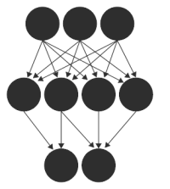






Deep Learning
Abdallah Musmar

Slide 2
Input X
Output Ŷ
.
.
.
.
.
.
.
.
.
.
.
.
.
.
.
.
.
.
.
.
.
.
.
.
.
.
.
.
.
.
.
.
.
.
.
.
.
.
.
.
Output activation f(n)
1 value: Logistic Regression
Multiple values :Softmax

Slide 3
What happens inside?
Initialize weights and bias for the network (W, b) and assign an activation function (example: ReLU, tanh, sigmoid)
Loop ~1000 times
Estimate y using: (a)Forward propagation and (b)cost function ->optimization algorithm example: gradient descent
Calculate dW,db, and other derivatives for every layer
Update the node values: W= W-αdW … same for others
Iterate until loss of cost function reaches its minimum

Slide 4
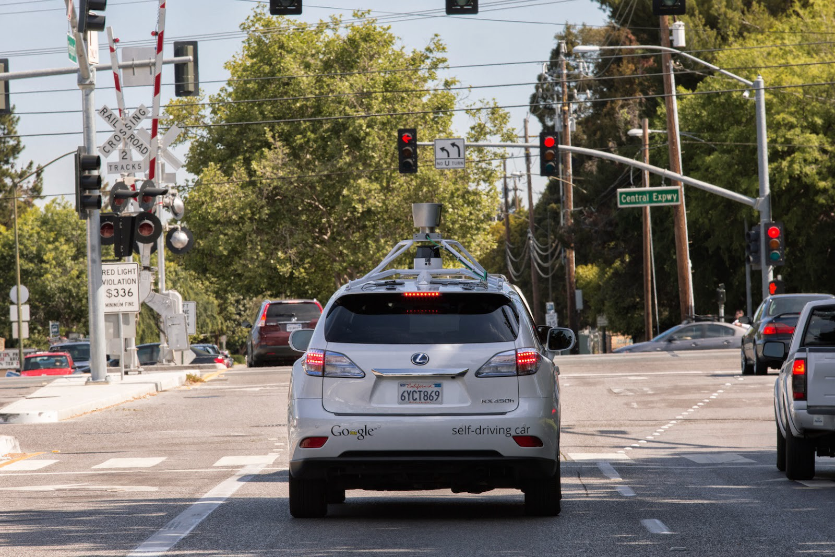
Application: Object Detection using Deep Learning
Input X
Output Ŷ
light
light
street
light
car
light
sign

Slide 5
Using CNNs with images
Because images have high resolution ~1000X~1000X3 (hXwXRGB)
Abdallah: Draw on the board the 64X64X3 to show what we need to compute
With convolutional neural networks, you can do:
Filters (to detect edges like vertical, horizontal, 45 degrees … etc)
Padding (to NOT loose the image boundary, example p=2)
Strides (to move the filters quickly, example s=3)
Max Pooling (take an area of the picture and pick the max value, some papers pick the average, but the majority pick the max)
What do these operations do
Object Detection: Sliding window, R-CNN, YOLO algorithm
YOLO inspired by GoogLeNet “Inception” model paper here

Slide 6
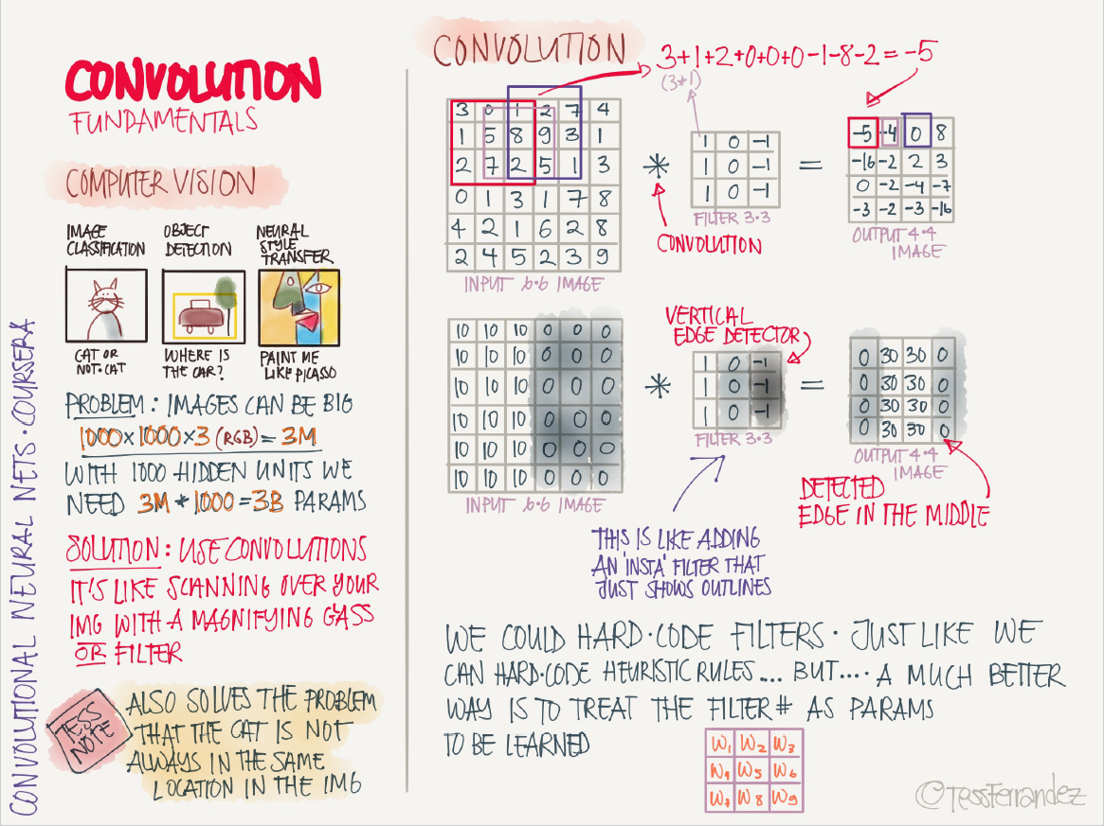

Slide 7
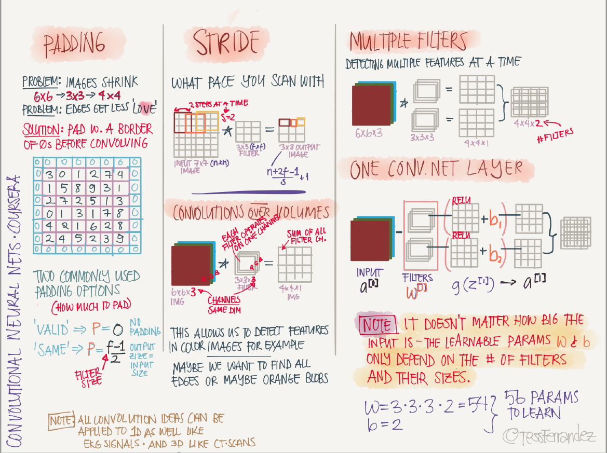

Slide 8
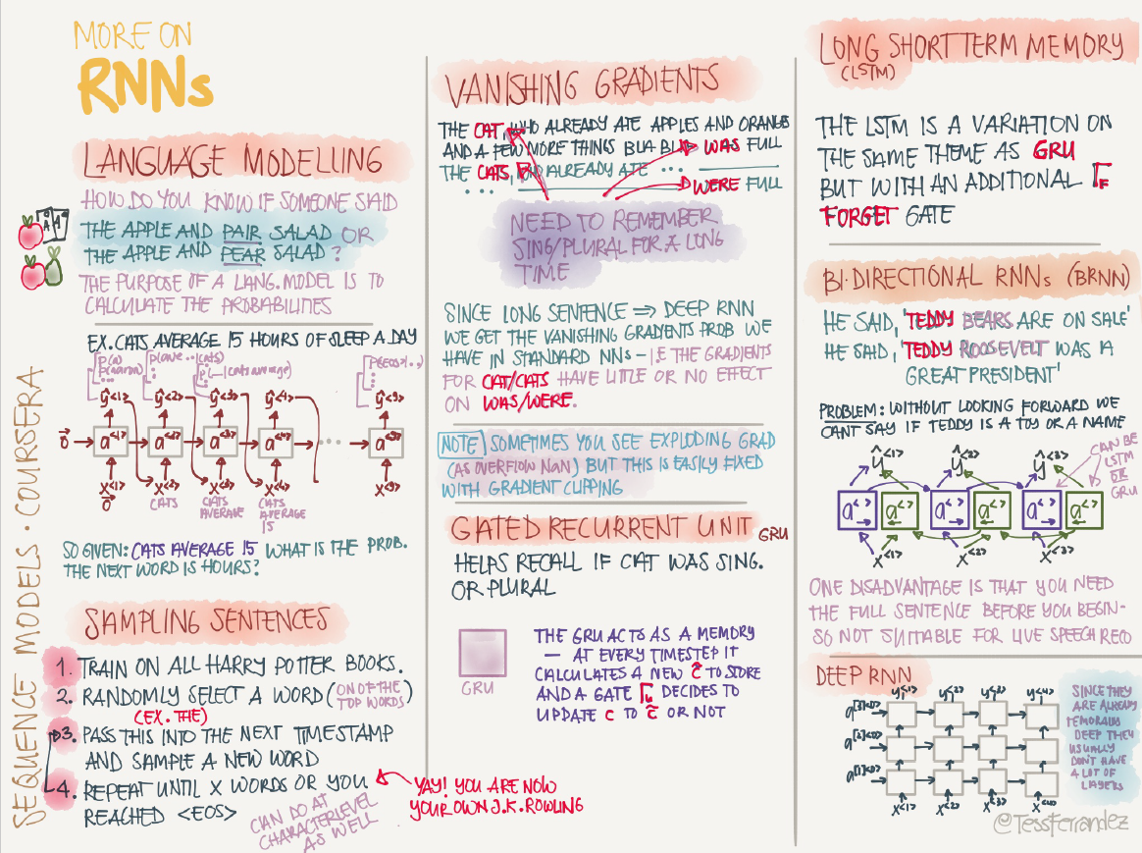

Slide 9
YOLO: You Only Look Once
A single CNN simultaneously predicts multiple bounding boxes probabilities
Input -> 24 convolutional layers -> 2 FC -> Output
Probability of detecting an object, then identifying its class
Bounding boxes (example: vertical for people & horizontal for cars)
Draw the output vector of pc and bx,by,bh,bw, …. bn c1,c2…cn
Use non max suppression to discard all boxes with p<threshold
For the remaining boxes, pick the largest p and discard remaining box with IoU>0.5
Looks at predicting objects as a regression problem with a probability p

Slide 10
YOLO: You Only Look Once
Steps: Resize, Run CNN, Threshold results
The Output Layer
Divide the image into a grid of SXS (S=7)
Each grid cell predicts B bounding boxes simultaneously (B=2)
There are C classes in the training dataset (C=20)
Output tensor dimensions are SXSX(B*5 + C) = 7X7X30
If the center of the object is in a grid cell, then that grid cell is responsible for detecting the object
For the final layer:
Width, height, and box coordinates are normalized
Relu activation function
Optimize use SSE

Slide 11
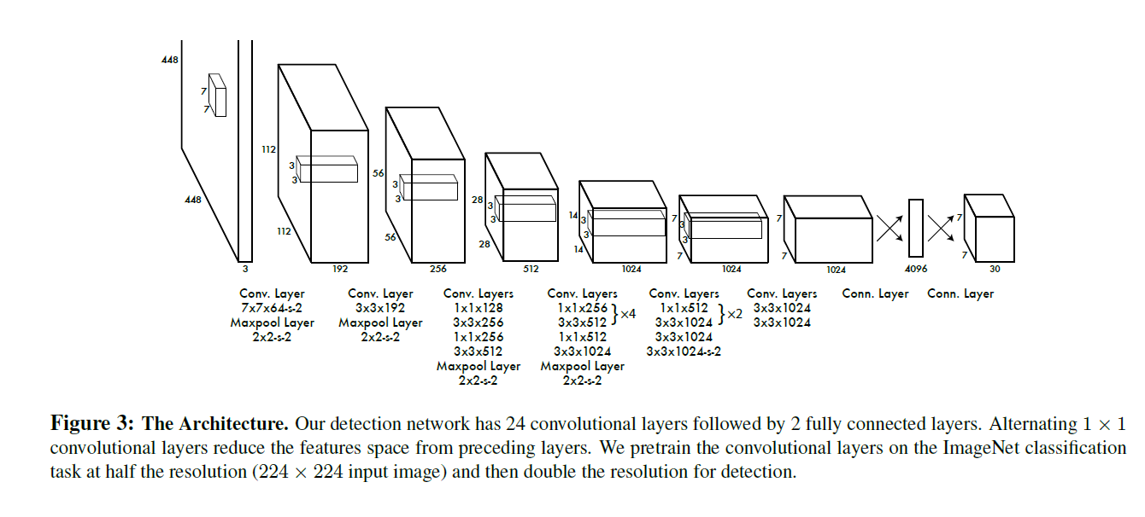

Slide 12
What to do with all the data? PNAS paper
Socioeconomic studies might be facilitated by computational methods
US Census Bureau - American Community Survey ($250M/yr)
Automated data analysis may become a supplement
By estimating make/model/year of the cars, we can predict income/race/education/voting_patterns
IF(Sedans>Trucks) THEN 88% more chance of voting Democrat
Train model on few cities -> create nationwide estimates

Slide 13
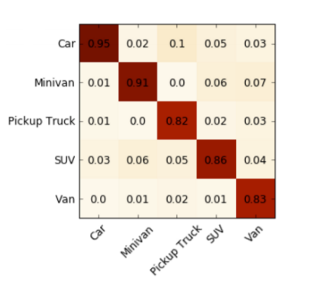
More on the data
Accuracy
50 million images across 200 cities, 3068 zip codes
Cars = 2657 categories
almost all automobiles sold in the US since 1990
Object Recognition algorithm = Deformable Part Model (DPM)
Used ImageNet Nips-2012 CNN paper to develop the CNN
Training set -> 35/200 cities, 15% zip codes, 12% voting precincts
Test set -> the rest (I don’t feel comfortable about this percentage)

Slide 14
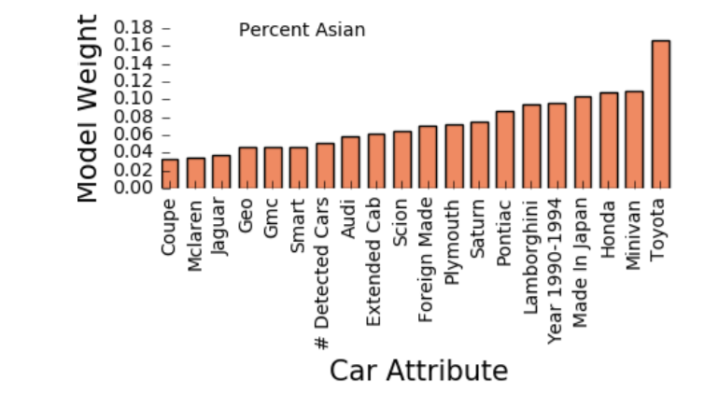
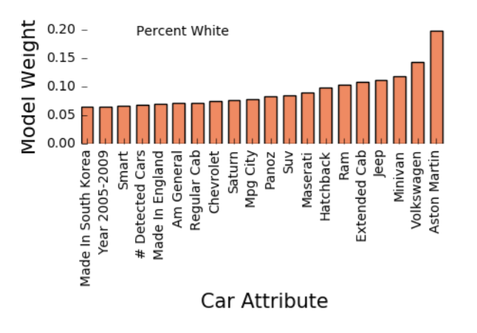
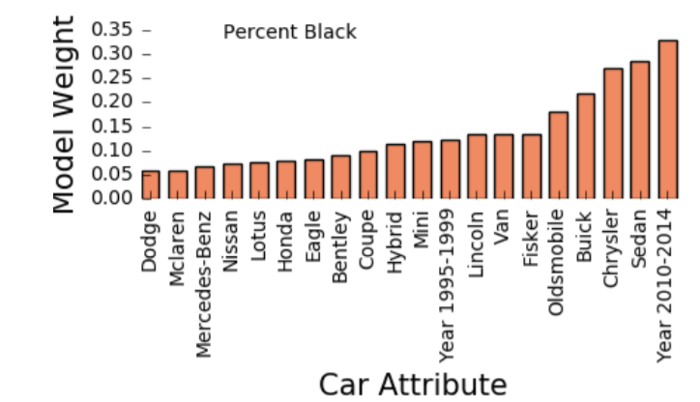
More on the model
Logistic Regression -> estimate race & education levels (binary??)
Ridge Regression -> estimate income & voter preferences
(no more unbiased estimator -> βridge chosen to min SS)
Associations (This is not me, research indicates these associations)
Chryslers/Buick -> African Americans
Pick up trucks/VW -> Caucasians
Hondas -> Asians -> Democrats

Slide 15
Checking model accuracy
Comparing the test set (165 cities) with model estimates
Strong correlation between the results and ACS values
Example: accurately estimating race distributions in Seattle zip codes
For voter preference data, compare test set to 2008 election results city-by-city and precinct-by-precinct -> strong correlation (r=0.57?)

Slide 16
Suggested improvements
Object detection beyond vehicles
Incorporating global image features
Integrating other types of data: satellite images, social networks

Slide 17
Questions?

Slide 18
Thank you! ☺

